Slide 1
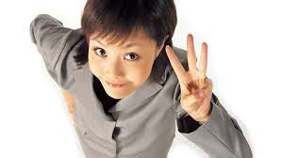
Negotiation Fundamentals
Reading 1.1
Three Approaches to Resolving Disputes:
Interests, Rights and Power

Slide 2
Negotiations Mixer
I need 3 volunteers
TASK: In a team of 3, negotiate with your partners to decide how you would divide this $10 among you.
Once you have agreement, all 3 of you stand up.
You have 60 seconds to negotiate. Are you ready to begin?
Go!

Slide 3

Negotiations Mixer
Did you reached a win-win agreement in 60 seconds?
What made this a difficult task?

Slide 4

Effective Negotiations
Goals of this Class
Learn new and effective negotiation techniques
Learn by doing and interacting with others

Slide 5
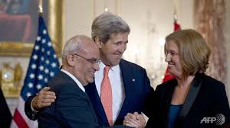
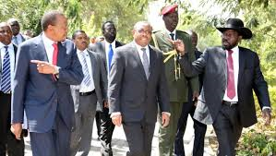
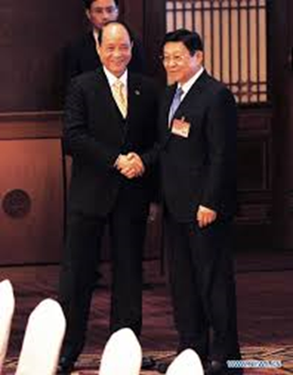
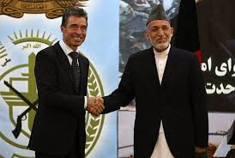
What is Negotiation?
Whether at a bargaining table with labor and management; a law office with plaintiffs and respondents; Camp David with international combatants; a hostage situation; or a mediation between an employee and supervisor, the definition is the same

Slide 6
What is Negotiation?
To “Negotiate” is to arrange or settle by conferring or discussing; or to use information and/or power to affect human behavior in an environment filled with multiple issues and tensions
Any communication between two or more persons with an intention to persuade

Slide 7
Negotiations are pervasive…
In everyday life with family and friends
In business
In political life and government
In academia
In deal-making, conflict resolution, problem solving, and decision making
Negotiation is a crucial business and management skill. All of us negotiate every day.

Slide 8
Characteristics of Negotiations
Two or more parties are involved
There exists a perceived conflict of interest between those parties
Parties chose to negotiate because they believe they can influence each other to get a better deal than what they would otherwise get if action was unilateral

Slide 9
Characteristics of Negotiations (cont)
Parties expect to experience “give and take” during their negotiations as each side compromises positions
Parties expect that negotiations will allow them to manage both the “tangibles” and the “intangibles” contained in their issues
                From “Essentials of Negotiations” by Lewicki, Saunders

Slide 10

So, What’s The Problem?
Negotiations often fail
Deals are not made
Disputes as protracted
Relationships are damaged
Money and time are wasted

Slide 11
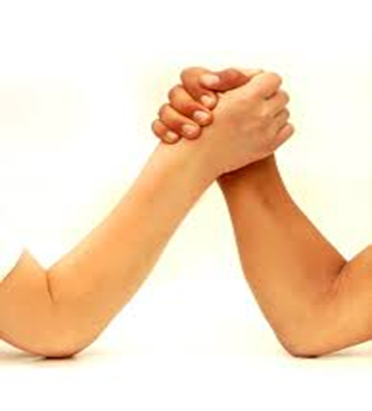
Exercise

Slide 12
Possible Causes of Problems
Parties may not:
  Be open about their desired outcomes
  Be clear in their own minds about what they actually want to accomplish with their proposals
  Reveal all of the truth regarding their positions to each other

Slide 13

Possible Causes of Problems (c0nt)
Parties may not:
  Be willing to believe all that they hear from each other.
  Have the right negotiators.
  Be ready to settle.

Slide 14
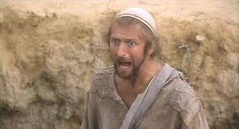
Bargaining vs. Negotiation
Most people think bargaining and negotiation mean the same thing:
https://www.youtube.com/watch?v=u75XQdTxZRc
Monty Python: Life of Brian
(The Haggle Scene)

Slide 15
Bargaining vs. Negotiation
We will be distinctive about the way we use these two words:
Bargaining: Describes the competitive, win-lose situation
Negotiation: Refers to win-win situations such as those that occur when parties try to find a mutually acceptable solution to a complex conflict

Slide 16

Traditional Negotiation Relationship
Assumption
  For me to win, you must lose: therefore, we must compete

Slide 17

Traditional Negotiation Relationship
Assumption
  To help you is a sign of my weakness and it will hurt me: therefore, little real communication

Slide 18
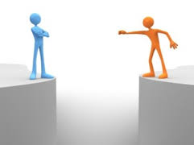
Traditional Negotiation Relationship
Assumption
  My power comes from opposing, criticizing and beating you: therefore, parties are more rigid

Slide 19
Traditional Negotiation Relationship (cont)
Outcomes
  One-sided victories (Win-Lose)
  Split-the-difference compromise
  Escalation into conflict
  Costs high to both parties
  Neither party fully achieves goals
  May lead to decay and decline of both parties

Slide 20
So, What is the Goal of Negotiation?
To reach a desired and durable result by including the interests of both parties
To reach agreement efficiently and fairly using talents of all participants to solve problems
To develop a shared sense of satisfaction from working together successfully

Slide 21
Good Negotiating Outcomes
Better Than Alternatives Away From The Table
Satisfies Interests
The Best Among Many Options
I Do Not Feel Taken – A Legitimate Outcome.
Efficient Process – Requires Good Communication
Realistic Commitments - Likely to Comply, Easy to Implement
Leaves Us With A Good Working Relationship
Me: Well Satisfied
You: Acceptable
Both: Your problem is my problem

Slide 22

What is the foremost negotiation question?

Slide 23

Exercise:
Carolina Blue Tree

Slide 24
Positions
15
Positions are...
something one has decided as a way to settle a conflict or a difference
a pre-determined solution

Slide 25
Problems with Positions
17
Predetermined way to solve problem
Don’t understand real interest of parties in dispute
Limits creative options

Slide 26
Interests are...
18
Interests
needs, beliefs, values underneath positions or,
why something is important

Slide 27

Position
Tangible item people say they want.
Arguing over positions.
Inefficient
Negative effect on relationship
Interests
Intangibles people want, need, hope, or fears.
Miner:
Boots.
Shift pay.
Company:
Interest of in the miner working his
assigned shift.

Slide 28
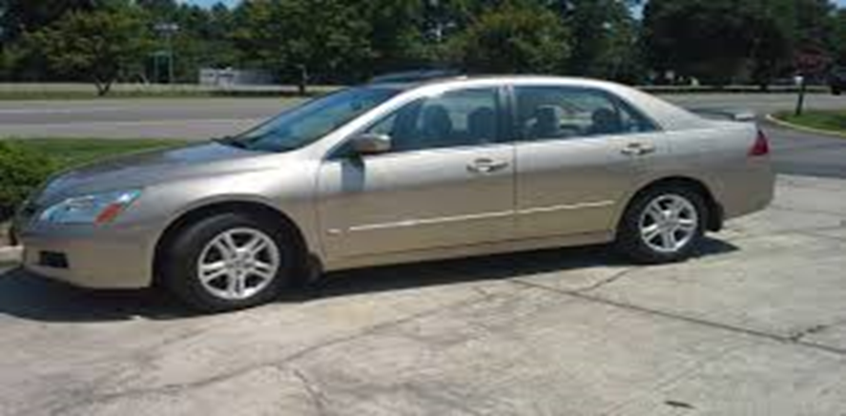
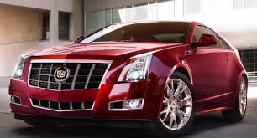
Positions versus Interests

Slide 29
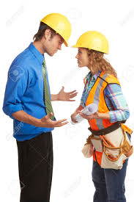
Positions vs. Interests: Example
A Position- Based Negotiation Between SUB and GC:
  SUB: I will not be able to finish on time.
  GC: You will finish as scheduled.
  SUB:I need two extra weeks.
  GC: You cannot have two weeks.
  SUB: If I do not get two weeks, I will not be able to finish on time.
  GC: No, you will finish according to the contract or we will collect damages and replace you.

Slide 30

Positions vs. Interests: Example (c0nt)
An Interest-Based Negotiation Between SUB and GC:
  SUB: I will not be able to finish on time.
  GC: Why Can’t you finish as promised? What are the reasons?
  SUB: My supplier will not be able to deliver the materials until next week, causing me to finish two weeks behind schedule.
  GC: As you know, the schedule is very tight for this project and there is little float available. Are there any other suppliers who can deliver on time?
  SUB: Yes, but they are more expensive, more than the damages incurred by finishing late.
  GC: Although you are responsible for meeting the milestone, I understand your dilemma. Let me see what I can do. I know some other suppliers that might be able to help.

Slide 31
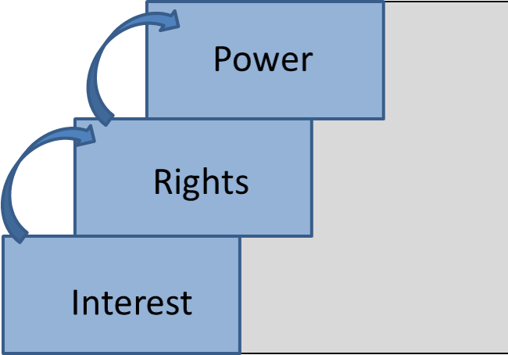
Approaches to Negotiation
Negotiations can be:
Power Based
Rights Based
Interest Based
The outcome of any agreement will reflect
the extent and manner in which the parties
deal with these basic methods of negotiation.

Slide 32
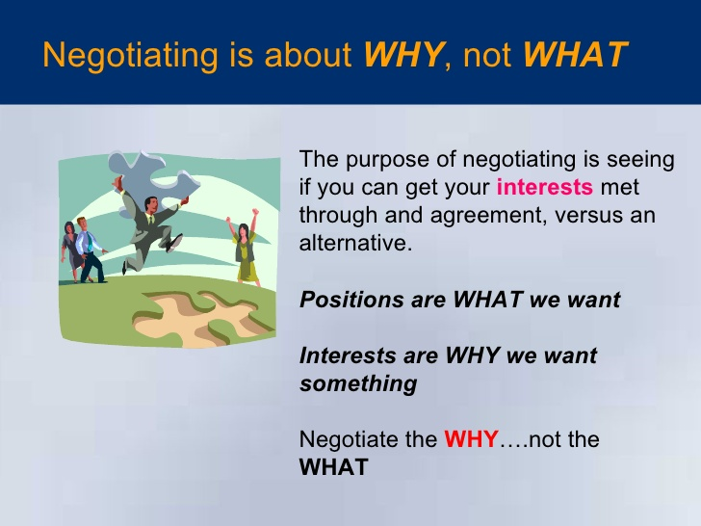

Slide 33

Interest Based Negotiation
Interests usually underlie positions
  The needs, goals, desires, and fears – the things people care about that motivate us to negotiate
Measure of success
  Satisfies parties’ interests
    Yours well, theirs acceptably, and others not directly in the negotiation tolerably enough to be durable

Slide 34
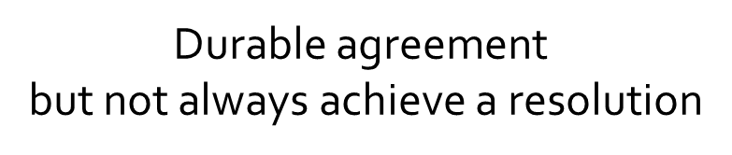

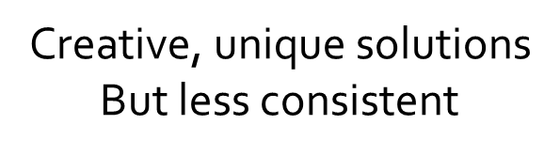
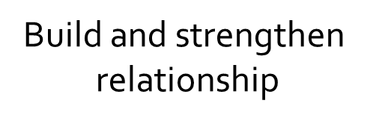
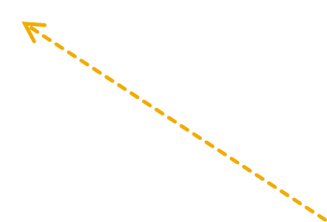
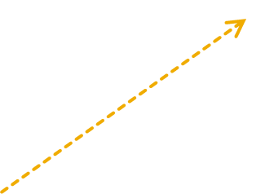
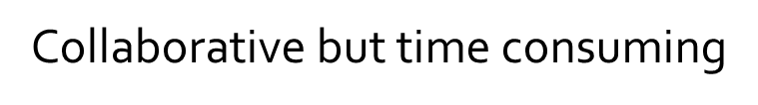
Issues with Interest Based Negotiation

Slide 35


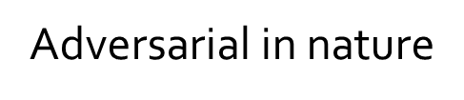

Right Based Negotiation
Focusing on the superiority of one party’s rights over the other party’s rights
Minimizing and de-legitimizing other party’s rights
Rights come from laws, policies, past practices, etc.
Litigation
Formal investigation
Arbitration
Some negotiation
types
Adjudication

Slide 36
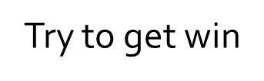

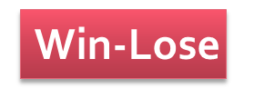
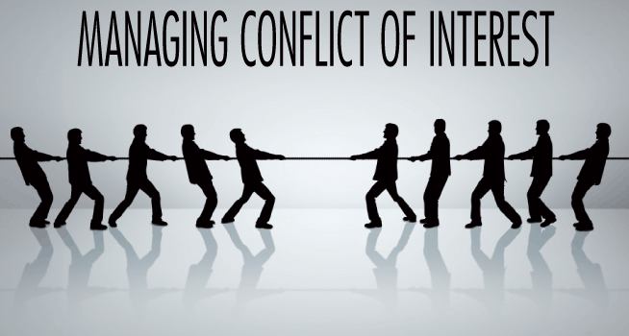
Power Based Negotiation
/
Lose-Loss
Highly adversarial
Threats, Physical force, Violence, Strike, Voting

Slide 37
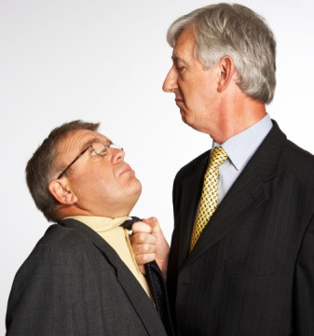
Issues with Power Based Negotiation
Once power is used,
more power is needed over time
Conquer but
hurting relationship
Fast outcome but no
durable solutions

Slide 38
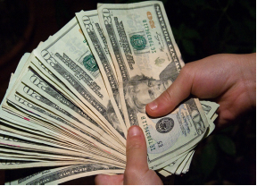


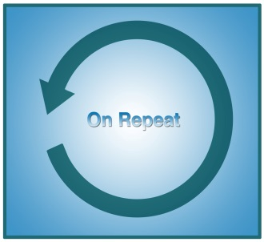
Criteria to Determine What is the Best Approach
Transaction Costs
  Economic
  Lost Opportunities
Satisfaction Outcomes
  Fairness of resolution and procedure
Effect on the Relationship
Recurrence
  What if the resolution fails to stick?

Slide 39
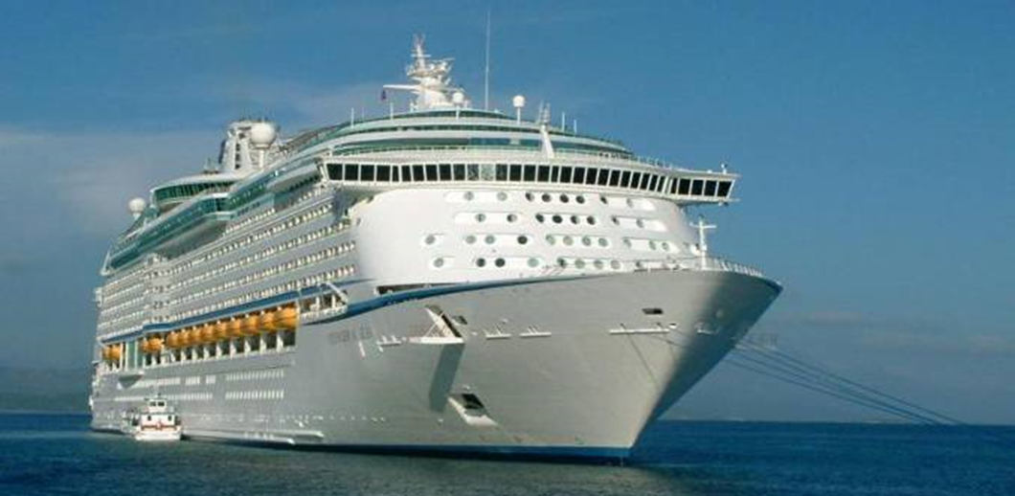
Vacation Solution
Husband
“I want a vacation at the beach”
His or Her Partner
“I want a vacation in Las Vegas”

Slide 40
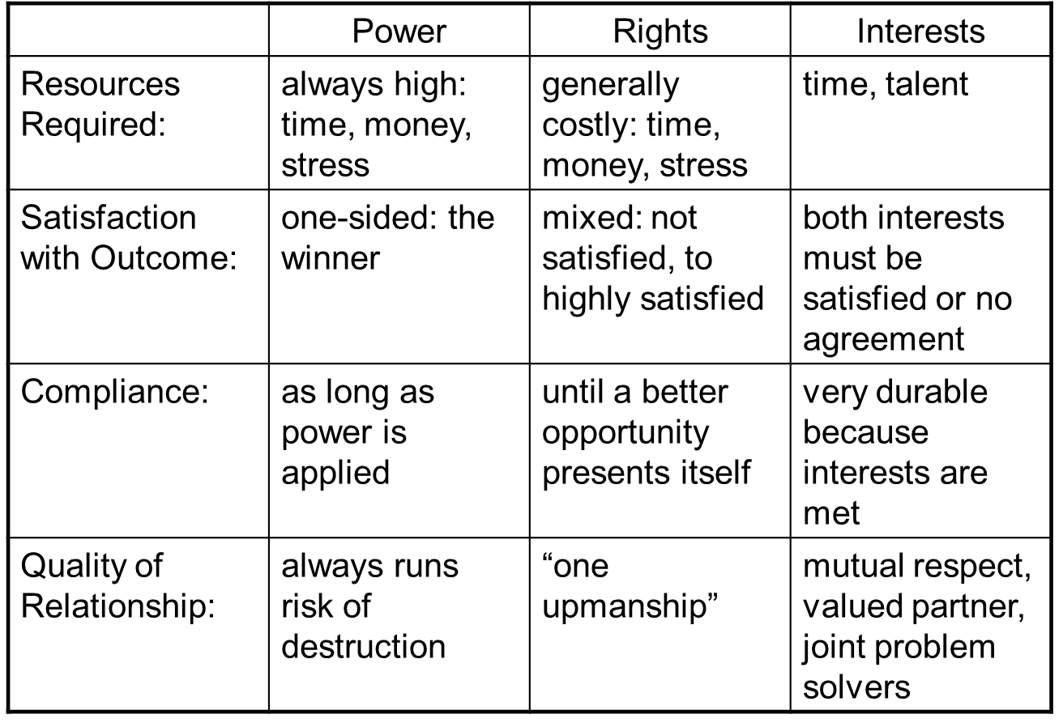
Summary:
Three Negotiations Approaches

Slide 41

Conflict

Slide 42
Conflict is….
Any situation in which your views/desires are not in agreement with another person’s and there is the perception that if his/her desires/views are met, then yours will not be

Slide 43
Recent Conflict Situations
Describe briefly a conflict situation that you recently experienced for which the outcome was pleasing to you
Describe another situation for which the outcome was NOT pleasing

Slide 44


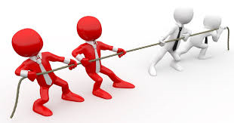
Three Levels of Conflict in Organizations
Interpersonal Level
  Personality differences
Group Level
  Trust, norm, and development
Organizational Level
  Goal, culture, and structure

Slide 45
Thomas-Kilmann Conflict
Mode Instrument
The Thomas-Kilmann Conflict Mode Instrument assesses an individual’s typical behavior in conflict situations and describes it along two dimensions
The model has 5 conflict modes

Slide 46

Thomas-Kilmann Conflict
Mode Instrument
Please complete the instrument
Thank you!!!

Slide 47
About Your TKI Scores
There are no “best” scores
There is no “right” style
All five modes are useful in some situation.
Each mode represents a set of useful social skills when used correctly
The effectiveness of a given conflict-handling mode depends upon the requirements of the specific situation and the skill with which the mode is used

Slide 48


